Slide 1

Exploring Global Happiness
From the 2019 Happiness Dataset

Slide 2
AGENDA
Introduction
Dataset Description
Data Analysis
Factors Influencing Happiness
Case Studies(comparing the most and the least happy countries)
Conclusion
Q&A

Slide 3
1. INTRODUCTION
Overview of the Topic:
Happiness Index:
The Happiness Index,
part of the World Happiness Report by the UN,
ranks countries based on their citizens' happiness levels,
providing insights into global well-being.
Key Factors Influencing Happiness:
GDP per capita
Social support
Healthy life expectancy
Freedom to make life choices
Generosity
Perceptions of corruption

Slide 4
2. DATASET DESCRIPTION
Source of the Dataset: From Kaggle (Link)
Time Period Covered: 2019
Variables Included:
GDP per Capita: Higher income levels generally correlate with higher happiness scores.
Social Support: Strong social networks and support systems enhance overall happiness.
Healthy Life Expectancy: Better health and longer life expectancy contribute significantly to happiness.
Freedom to Make Life Choices: The ability to make personal decisions without constraint boosts happiness.
Generosity: Acts of giving and helping others are linked with higher happiness.
Perceptions of Corruption: Lower levels of perceived corruption in government and institutions are associated with higher happiness scores.

Slide 5
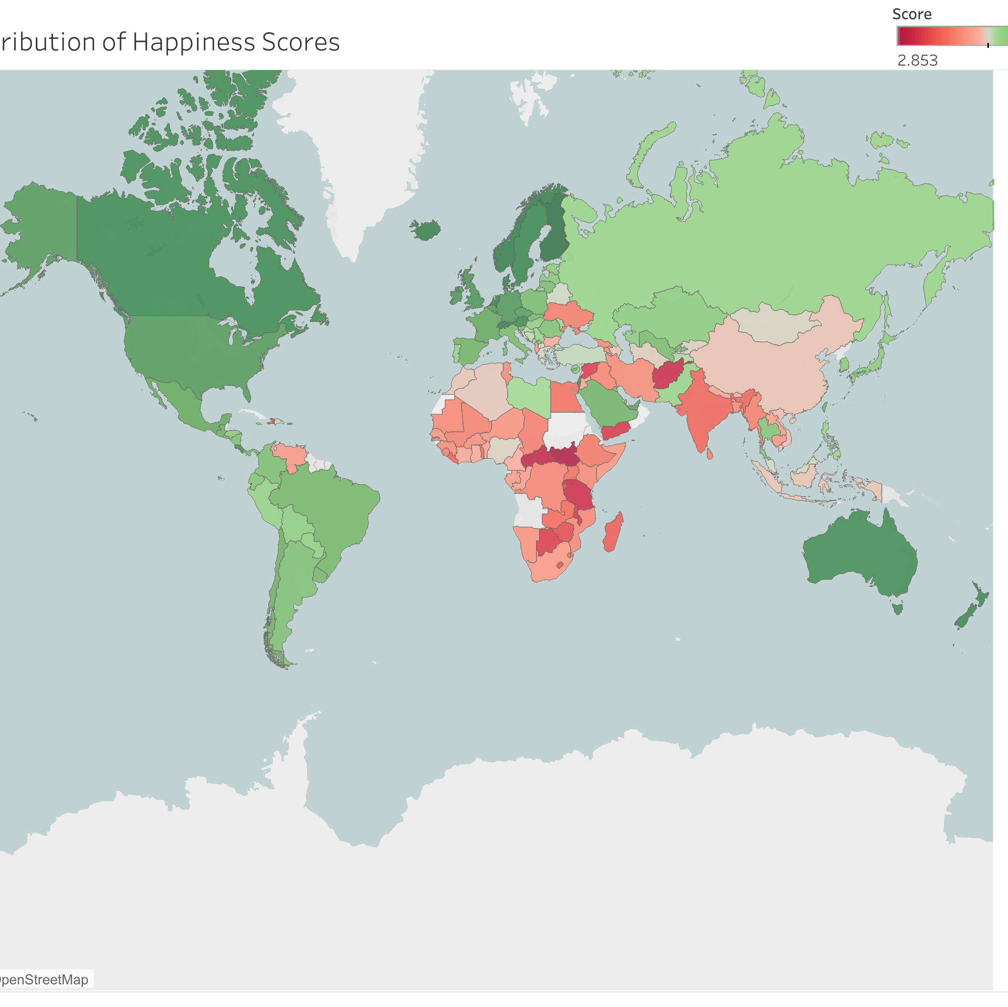
3. DATA ANALYSIS
Global Distribution of Happiness Score.
Score Continuous color scale: green for the happiest,
red for the least happy.

Slide 6
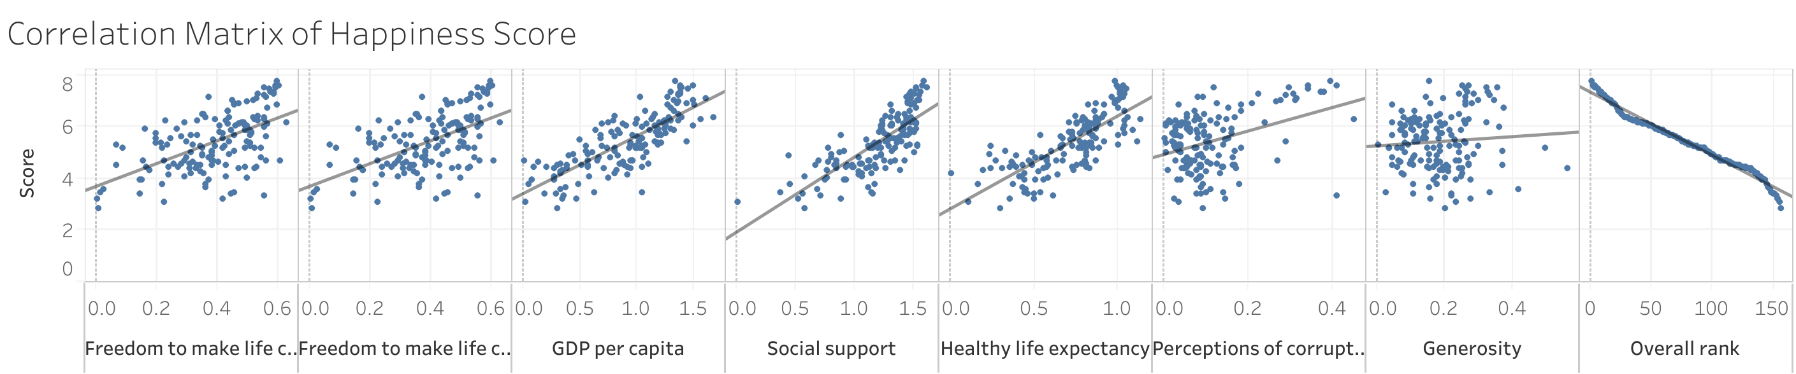
Correlation Analysis Between Variables
Analysis of how different variables relate to each other
Identification of strong positive and negative correlations
Notes:
We notice here that (GDP per Capita, Social Support, Healthy Life Expectancy) has the highest correlation with the Happiness Score.

Slide 7
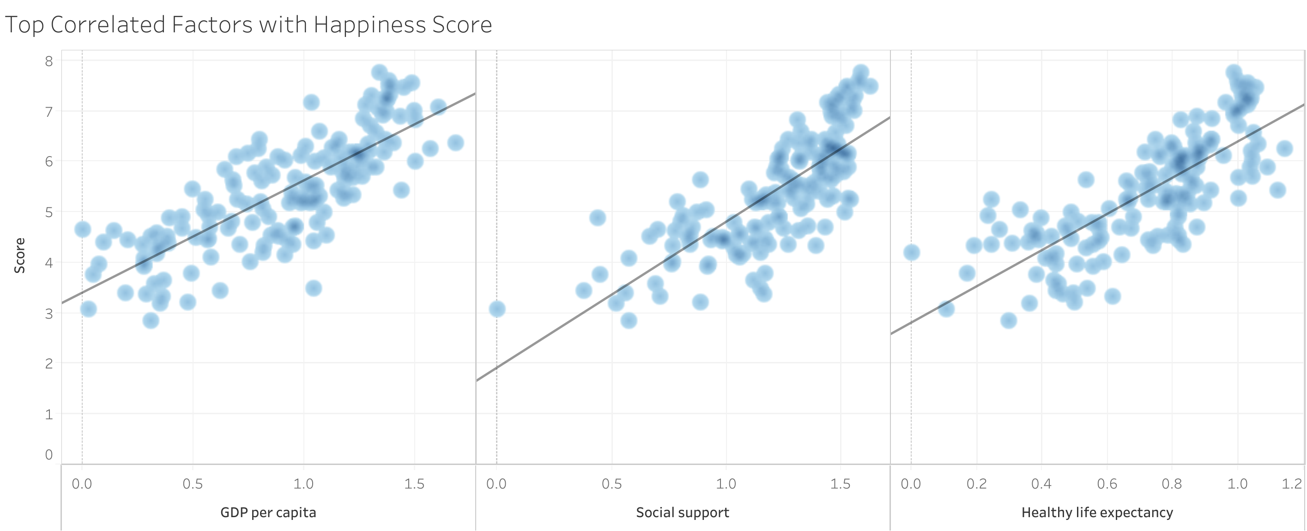
4. Factors Influencing Happiness
Correlation Matrix
showing the highest correlations between key variables (GDP per Capita, Social Support, Healthy Life Expectancy) and happiness scores.
Note: There is a positive relationship between them

Slide 8
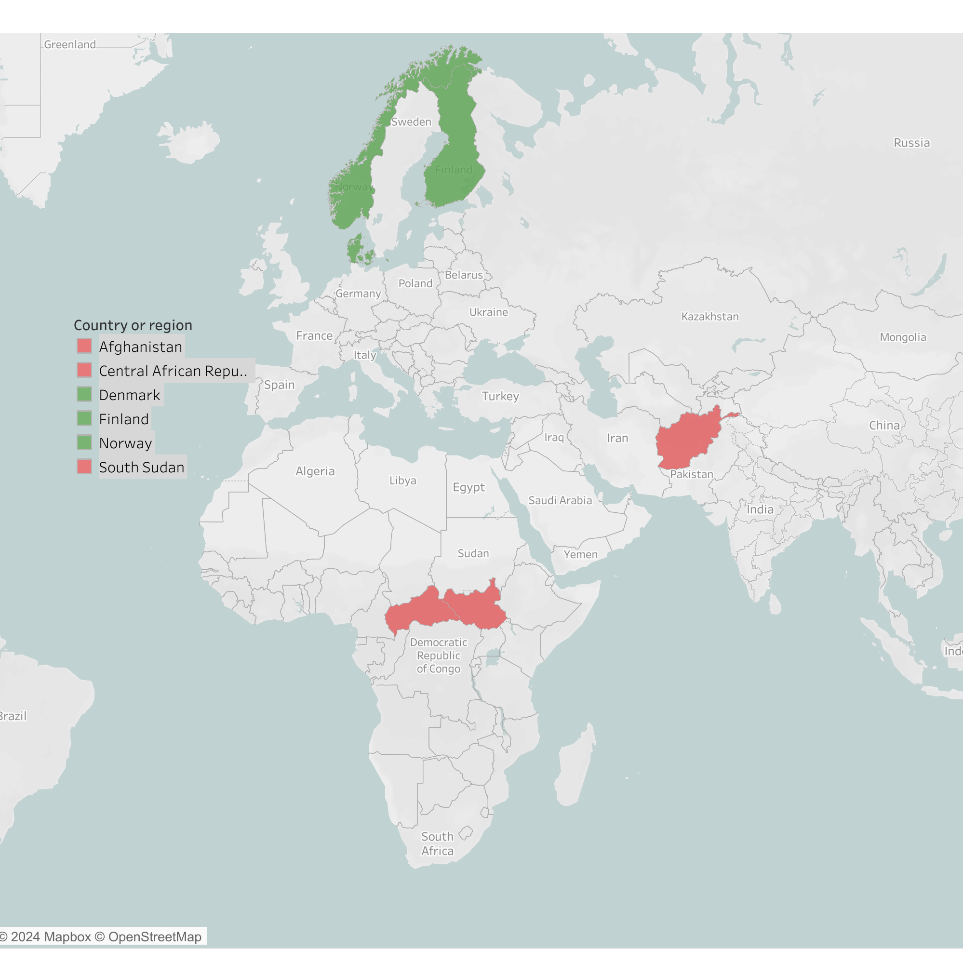
5. CASE STUDY
Comparing The Happiest 3 Countries
With The Least 3 Happy Countries…
Note:
Green color for the happiest,
Red for the least happy countries.

Slide 9
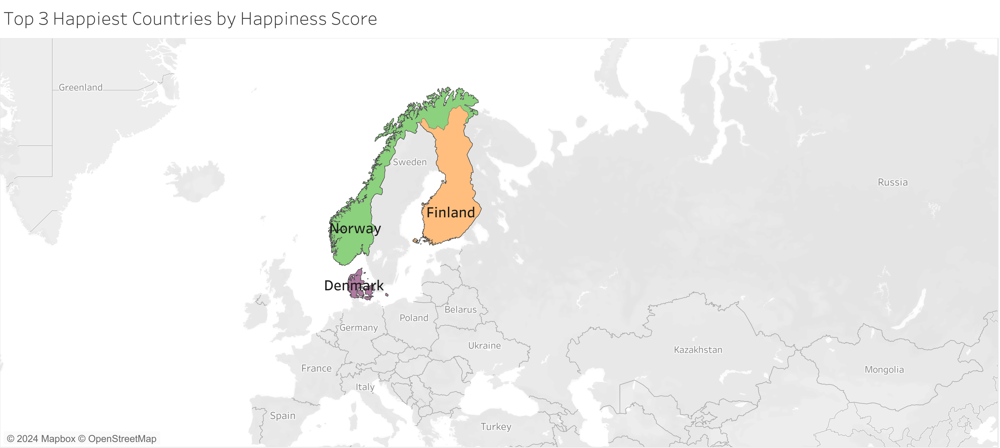
The Happiest Countries:
Common Strengths:
High GDP per Capita: Strong economic performance.
Excellent Social Support: Robust social welfare systems and strong community networks.
High Healthy Life Expectancy: Good healthcare systems and healthy lifestyles.
Freedom to Make Life Choices: High levels of personal freedom and autonomy.
Low Perceptions of Corruption: High trust in government and institutions.
Unique Factors:
Finland's emphasis on education and work-life balance.
Denmark's strong social equality and environmental consciousness.
Norway's wealth from natural resources and extensive social safety nets.

Slide 10
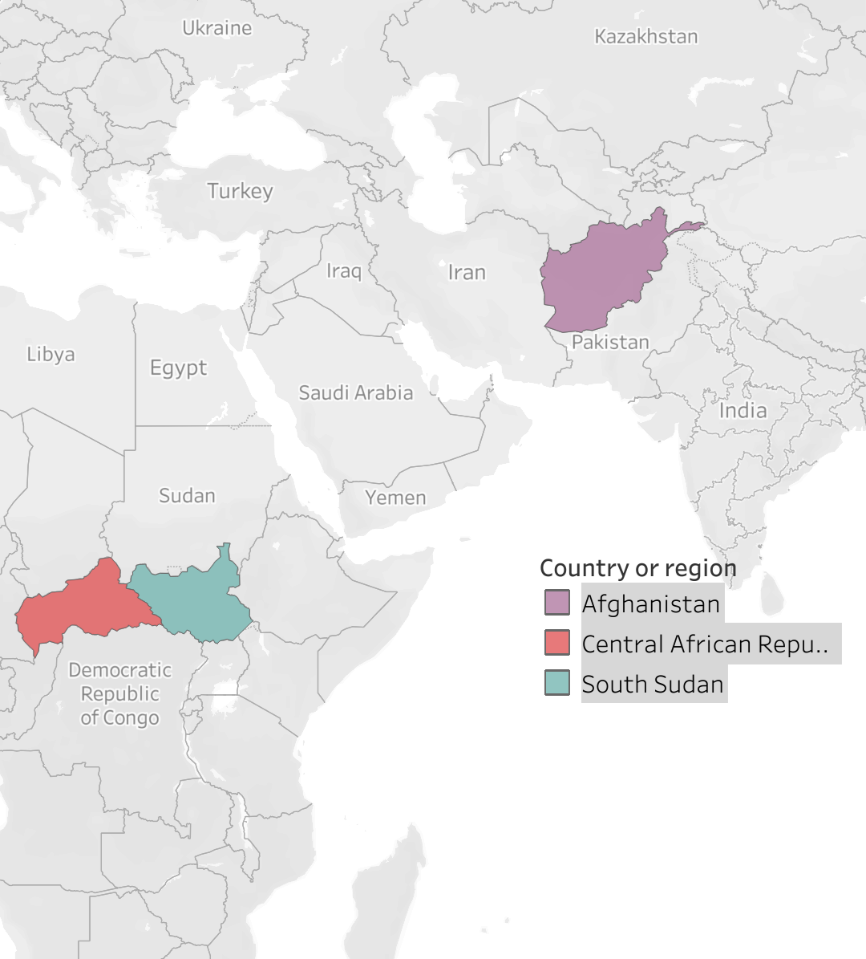
The Least Happy Countries:
Common Weaknesses:
Low GDP per Capita: Poor economic conditions and high levels of poverty.
Weak Social Support: Limited social services and support networks.
Low Healthy Life Expectancy: Poor healthcare systems and high mortality rates.
Limited Freedom to Make Life Choices: Restricted personal freedoms due to political instability and conflict.
High Perceptions of Corruption: Low trust in government and high levels of corruption.
Standout Negative Factors:
South Sudan's ongoing conflict and humanitarian crisis.
Central African Republic's political instability and lack of infrastructure.
Afghanistan's long-standing conflict and challenges in governance.

Slide 11
6. Conclusion
Summary of Key Insights
1. Economic Factors
Importance of GDP per Capita.
Strong correlation with happiness scores.
Economic stability and prosperity are significant contributors to a nation's overall happiness.
2. Social Support
Critical role of social support systems.
Countries with robust social networks and community support tend to have higher happiness scores.
3. Health and Well-being
Impact of healthy life expectancy.
Access to quality healthcare and a healthy lifestyle are pivotal for happiness.
4. Freedom and Governance
Importance of freedom to make life choices.
Low perceptions of corruption.
Personal freedom and trust in institutions are vital for a happy society.
5. Generosity and Community
Positive effects of generosity.
Societies that encourage acts of kindness and community support experience higher levels of happiness.

Slide 12

Q&A Session
Questions and Discussion

Slide 13

Thank you
Stay Connected
Email: 3bdo3laa@gmail.com
LinkedIn: www.linkedin.com/in/3bdo-3laa1

